Slide 1

Deep Learning for Humans
An Introductory Course

Slide 2
What
Open source DL library by Google
Python
Jupyter Notebooks

Slide 3
How
Learn by doing.
Minimal theory/math to get started with Tensorflow

Slide 4
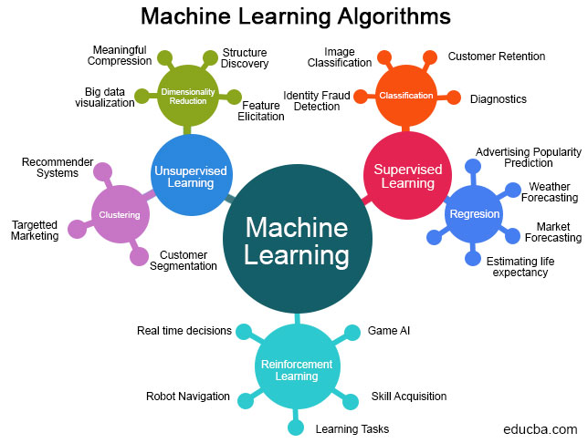

Slide 5
Black Box
Numbers
Numbers

Slide 6
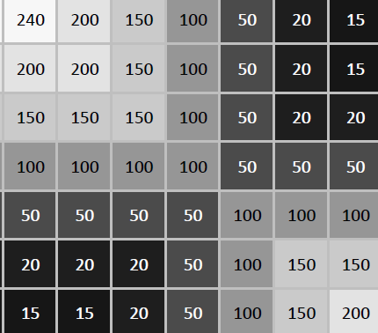
Numbers
Numbers
Black Box
0
1

Slide 7
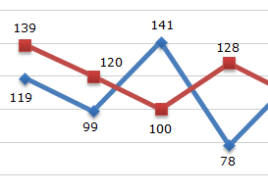
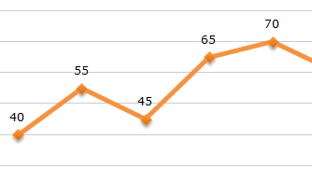
Numbers
Numbers
Black Box

Slide 8
Numbers
Numbers
Black Box
Deep learning for humans
인간을위한 딥 러닝

Slide 9

Numbers
Numbers
Black Box
인간을위한 딥 러닝

Slide 10
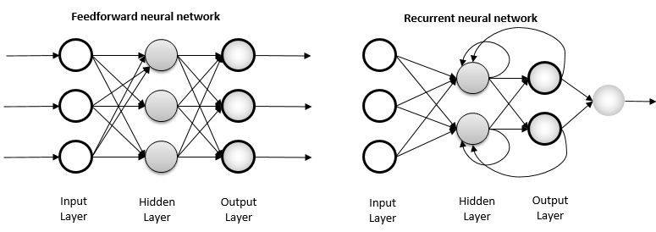
Numbers
Numbers

Slide 11
Weight
Neuron

Slide 12
Architectures
Feed forward
Recurrent
Multilayer Perceptron
Convolutional Neural Network
Simple Recurrent Network
Long Short Term Memory
Etc.
Etc.
Tabular data
Images
Sequences

Slide 14
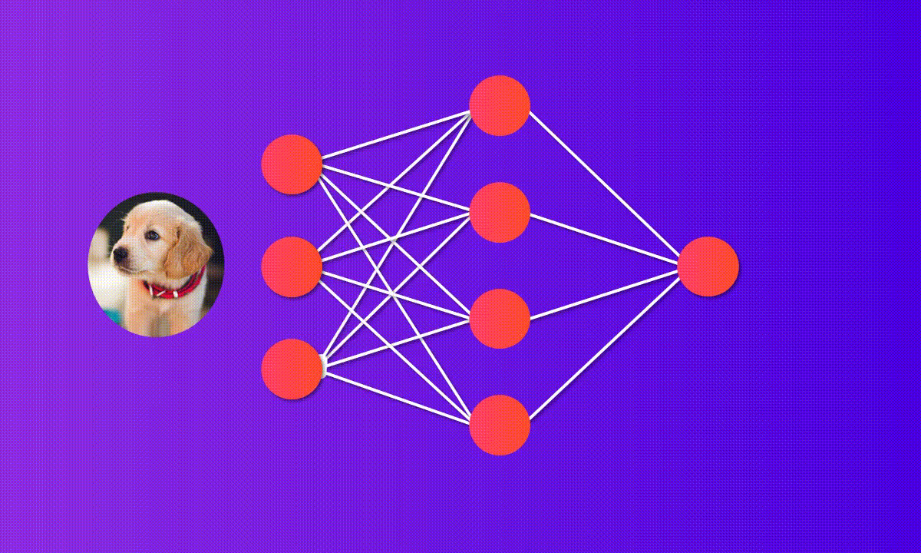
MLP

Slide 15
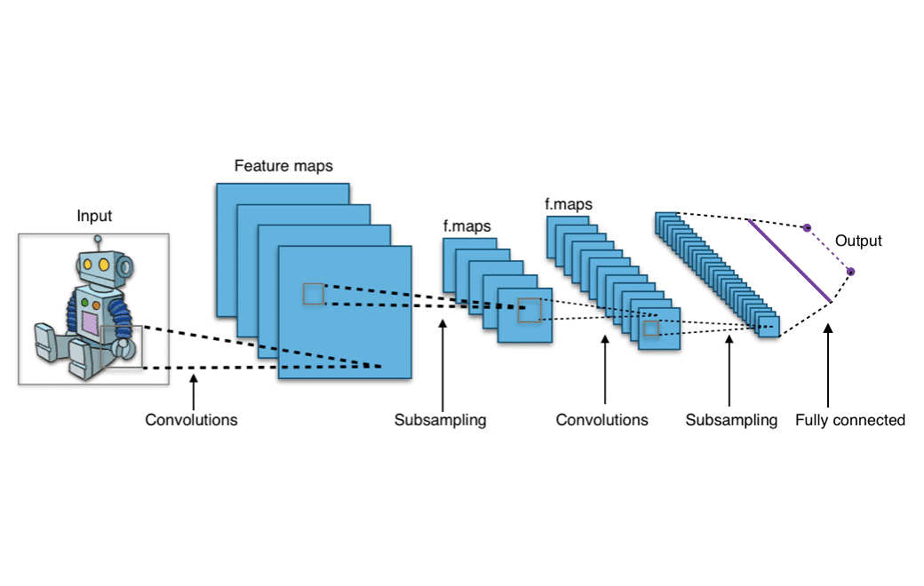
CNN

Slide 16
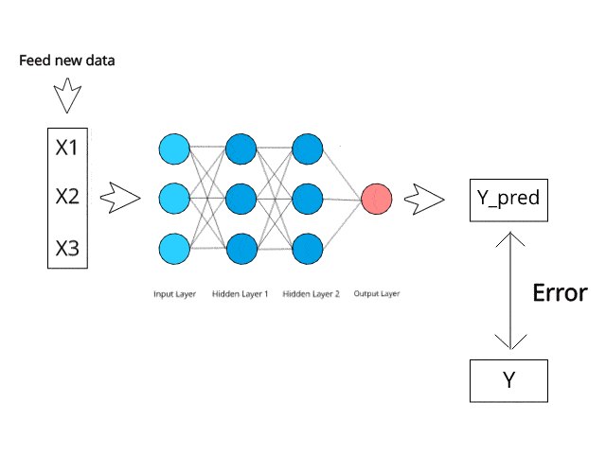
Learning with Backpropagation

Slide 17


Typical DL workflow
Prepare data
Define model
Train
Evaluate
Happy?
End

Slide 18
Jupyter Notebook
Google Colab (or go to colab.research.google.com)
Interactive demo

Slide 19
Module 1: MNIST

Slide 20
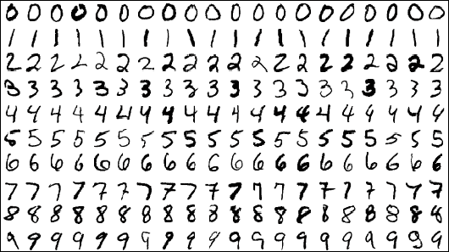
MNIST
Modified National Institute of Standards and Technology
The Hello World of Deep Learning
10 classes (0-9)
Image size: 28 x 28 pixels
SOTA: 99.84%
Human: 99.80%

Slide 21
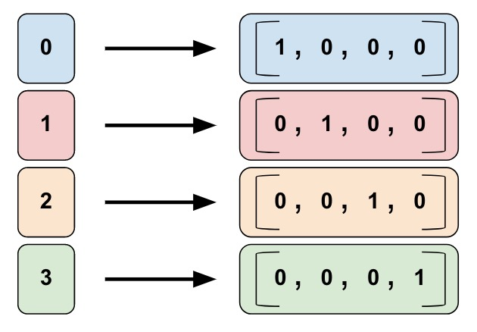
One hot encoding

Slide 22
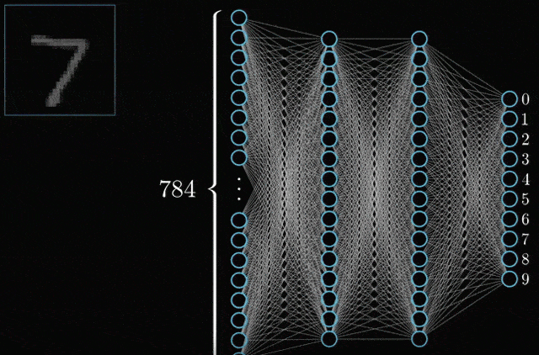
MLP

Slide 23
MLP: 97.0 ++ %
97+% accuracy with < 20 lines of codes
Open github.com/dnth/u10tfCourse

Slide 24
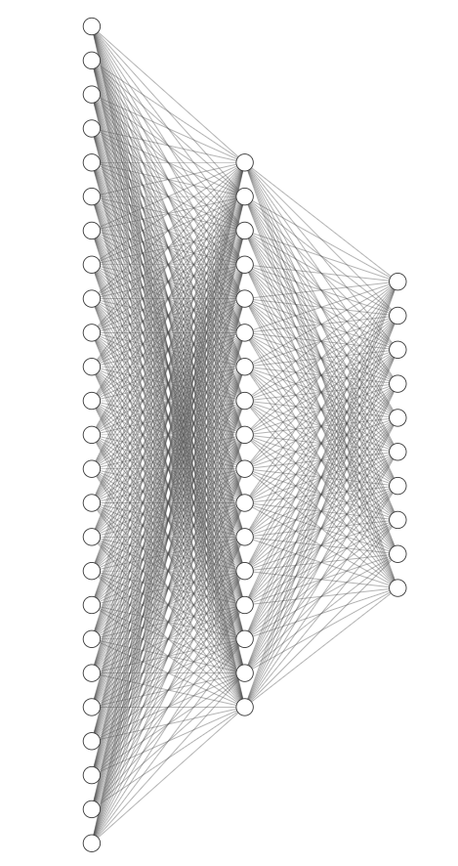
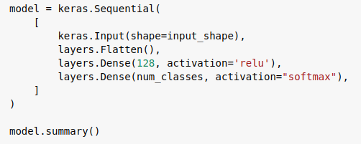
Hyperparameters
10 neurons
128 neurons
784 neurons

Slide 25
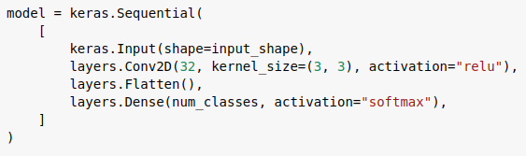
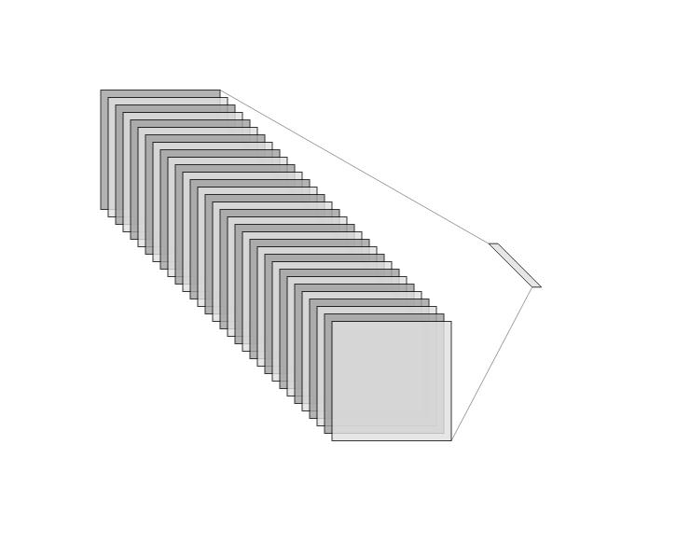
CNN: 98.0 ++ %
10 neurons
32 feature maps

Slide 26
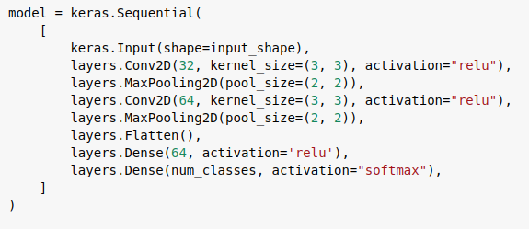
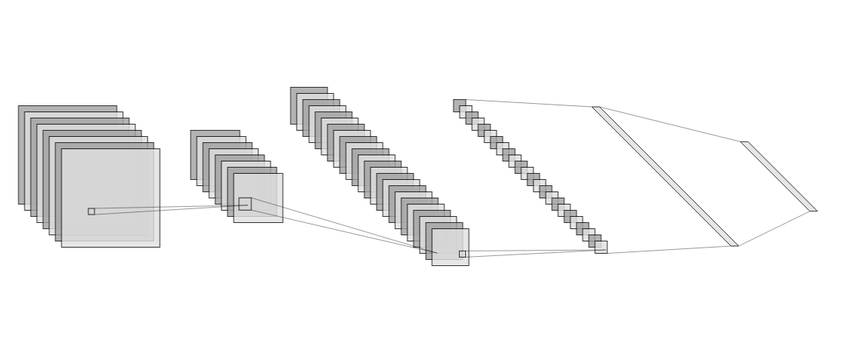
CNN Lenet: 99.0 ++ %
64 neurons
10 neurons
32 feature maps
64 feature maps

Slide 27
CNN

Slide 28

Convolution Operation
Image
Kernel
Feature map

Slide 29

Max Pooling Operation

Slide 30
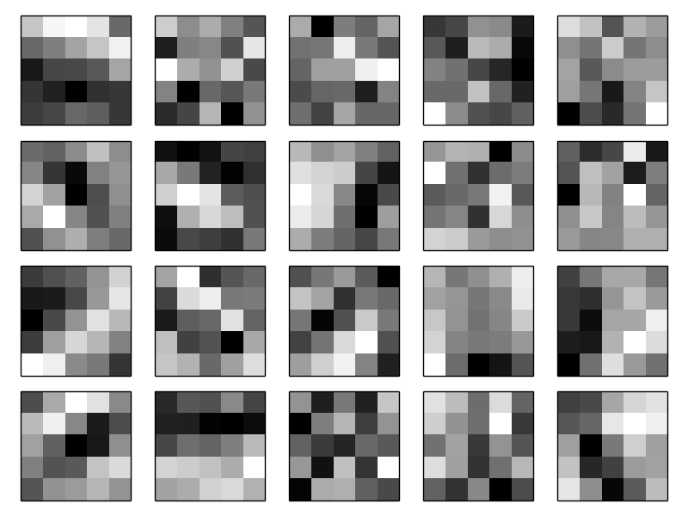
Feature maps learned from data

Slide 31
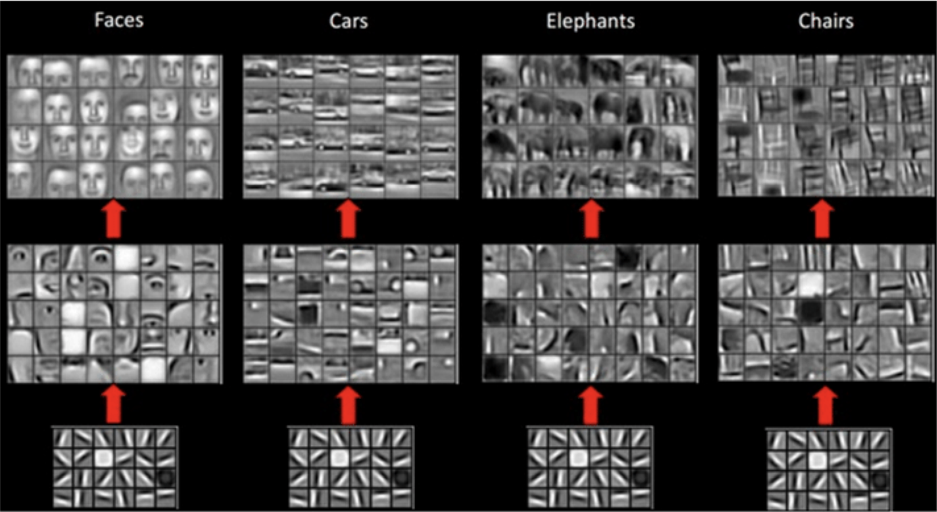

Slide 32

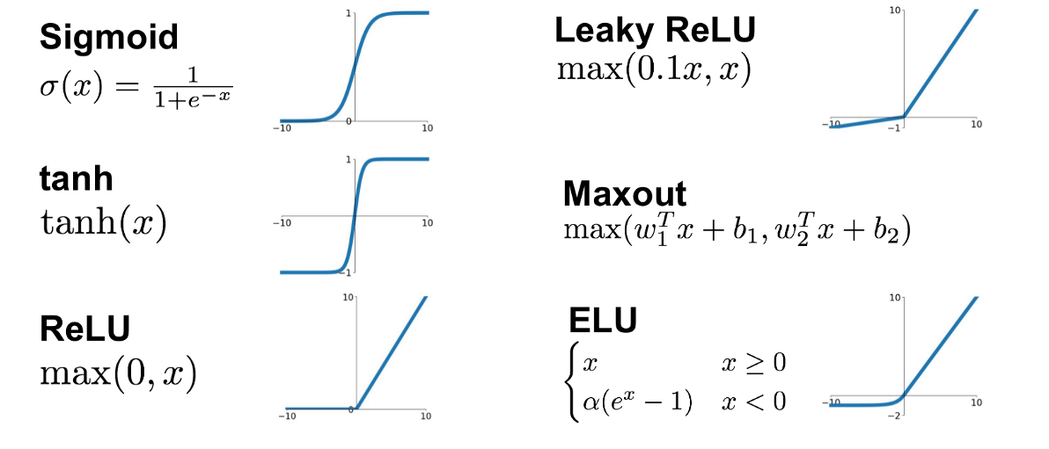
Activation Function
A function that defines the output of a neuron given the input

Slide 33
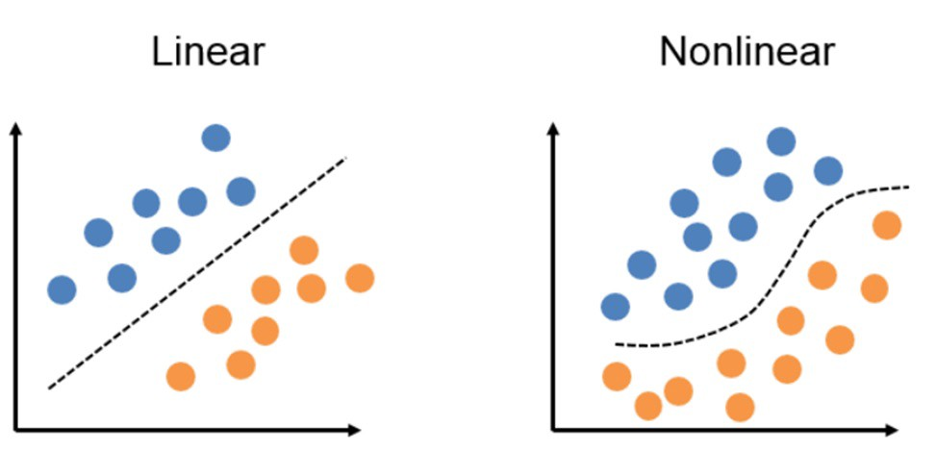
Non-linear curve with activation function

Slide 34
Typical DL workflow
Prepare data
Define model
Train
Evaluate
Happy?
End

Slide 35

Train the best classifier on the MNIST dataset
Tune the following hyperparameters
# filters
Kernel size
# neurons
Activation function: 'relu', 'sigmoid', 'tanh'
# epochs
# layers

Slide 36
Module 2: FaceNet

Slide 37
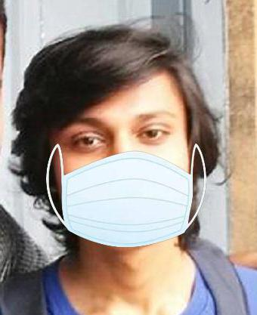
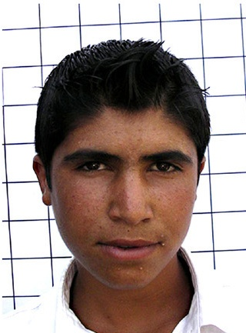
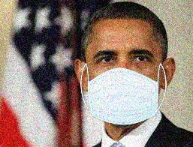
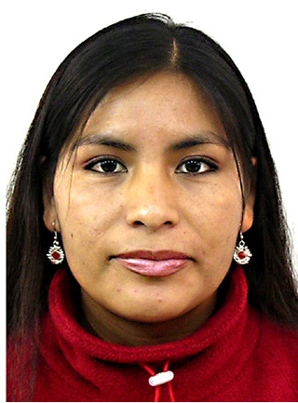
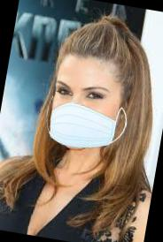
Dataset

Slide 38
Instructions
Download dataset
Upload dataset to Colab

Slide 39
Overfitting
Data Augmentation
Use Dropout layer
Transfer Learning

Slide 40
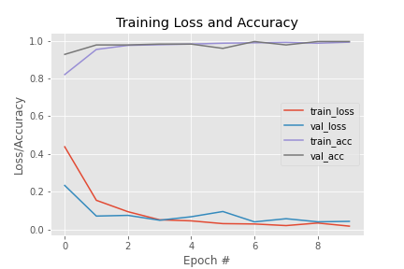
Learning curve

Slide 41

Overfitting
Underfit
Optimal
Overfit

Slide 42
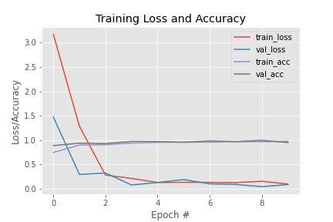
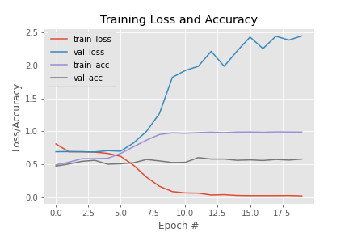
Signs of overfitting
High training accuracy, low validation/test accuracy
Normal
Overfit

Slide 43
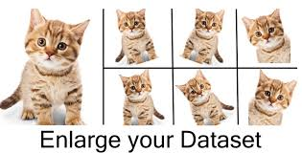
Data Augmentation
Rotation
Translation
Flipping
Zoom/Pan

Slide 44
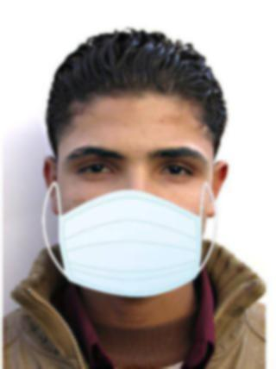
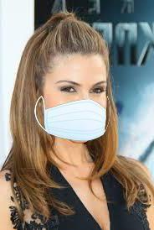

Data Augmentation
Mirror + Rotation
Rotation

Slide 45
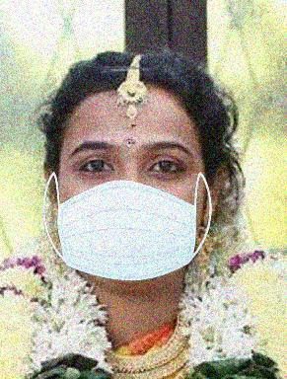
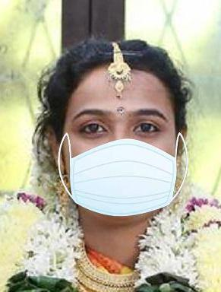
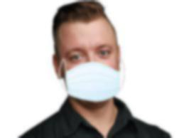
Data Augmentation
Translation
Mirror + Noise

Slide 46
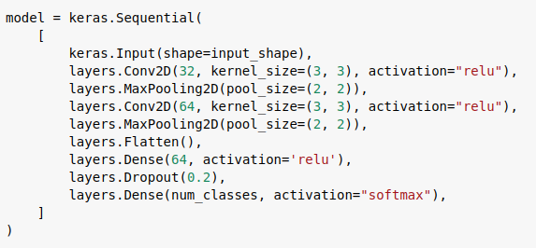
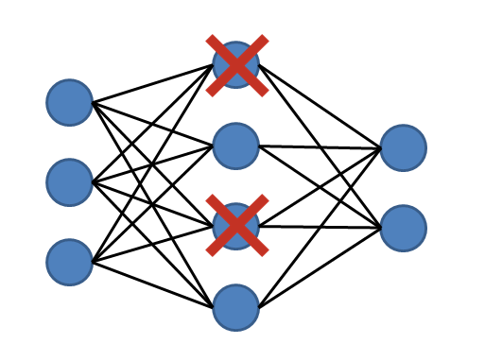
Dropout Regularization

Slide 47
Implement regularization techniques.
Train a MLP and LeNet on mask dataset.
Tune hyperparameters to yield the best accuracy.

Slide 48
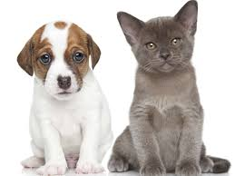
Module 3: Cats and Dogs

Slide 49
Instructions
Download dataset
Upload dataset to Colab

Slide 50
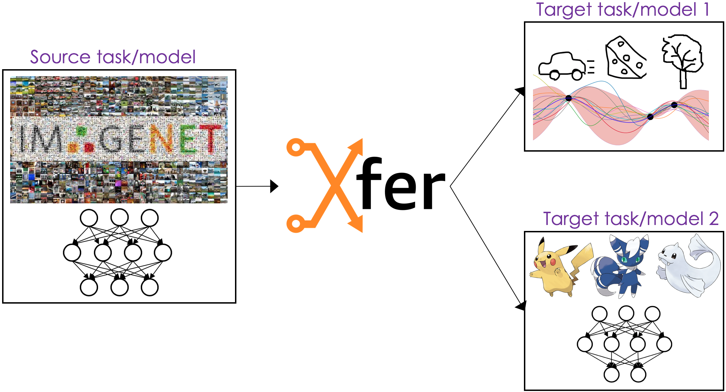
Transfer Learning

Slide 52
Base models
VGG
ResNet
MobileNet
Inception
Etc

Slide 53
Transfer learning model
Base Model
Flatten
Dense
Dense

Slide 54
Train the best classifier on the cats dogs dataset with transfer learning.
Tune the base model and other hyperparameters for best results.
With TL, you can get away training with very little data. But how little?

Slide 55
Other classification problems
ImageNet objects dataset
Pneumonia detection from covid-19 patients xray images
Plant disease identification from images
Product defect detection
Skin cancer detection

